Slide 1
AGILE Methodology
Chetan patil

Slide 2
Software Development Life cycle
Waterfall Model
V-Model
Iterative Model
--> Agile Methodology

Slide 3
What is Agile?
Agile development is a phrase used in software development to describe methodologies for incremental software development

Slide 4
Agile software development
Agile software development is a conceptual framework for software engineering that promotes development iteration throughout the life-cycle of the project
Software developed during one unit of time is referred to as an iteration , which may last from one to four weeks

Slide 5
Agile Manifesto
Individuals and interactions over processes and tools
Working software over comprehensive documentations
Customer collaboration over contract negotiation
Responding to change over following a plan

Slide 6
Existing Agile methods
Extreme programming (“XP”)
Scrum
Agile unified process

Slide 7
12 Principles are based on the Agile Manifesto.
1. Our highest priority is to satisfy the customer through early and continuous delivery of valuable software.
2. Welcome changing requirements, even late in development. Agile processes harness change for the customer’s competitive advantage.
3. Deliver working software frequently, from a couple of weeks to a couple of months, with a preference to the shorter timescale.
4. Business people and developers must work together daily throughout the project.
5. Build projects around motivated individuals. Give them the environment and support they need, and trust them to get the job done.
6. The most efficient and effective method of conveying information to and within a development team is face-to-face conversation.

Slide 8
12 Principles are based on the Agile Manifesto.
7. Working software is the primary measure of progress.
8.Agile processes promote sustainable development. The sponsors, developers, and users should be able to maintain a constant pace indefinitely.
9.Continuous attention to technical excellence and good design enhances agility.
10.Simplicity–the art of maximizing the amount of work not done–is essential.
11.The best architectures, requirements, and designs emerge from self-organizing teams.
12.At regular intervals, the team reflects on how to become more effective, then tunes and adjusts its behavior accordingly.

Slide 9
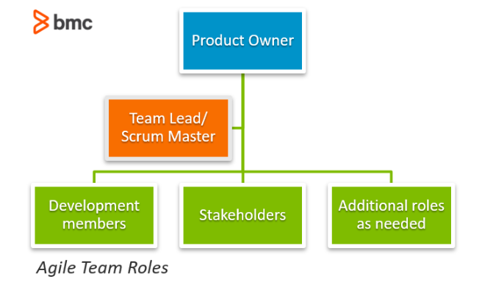
Roles in Agile

Slide 10
THANK YOU!

